Slide 1

Proofs
By Ariel Avshalom
Lecture 4: Proof by contradiction
CISC 2210

Slide 2
What we’ll cover
Chapter 10 of the book https://www.people.vcu.edu/~rhammack/Discrete/Alpha.pdf
We won’t cover the halting problem in this lecture, but may talk about in the future
The book gives a good brief explanation of it, but there is a lot of information available about it online

Slide 3

What is a proof by contradiction?
The only viable path
Any other way
Sometimes, the best way to prove something is to show that any other possibility is impossible

Slide 4

How does this work
We need to force a contradiction (C) by assuming that what we’re trying to prove is false
Then once we find a contradiction using sound logic, we follow back to the first line and show that that line is the only false one (i.e. assume our conjecture to be false)

Slide 5

General structure:
P = our hypothesis
Assume ¬P
A contradiction (⊥ or ↯ or ⇒⇐)
Therefore P
Beautiful and correct logic

Slide 6
A note on your contradiction
You need to show that somewhere along the line there is a contradiction
such that you assumed C ∧ found ¬C
The issue here is that you don’t know C going in
This is where proofs become hard
You don’t generally know that what you’re proving
is true or false coming in
In this class, doing lots of work will give you insight into the intuition and will make the exams easier
But it doesn’t usually work this way in the real world
You can spend years on a proof just to come up empty handed

Slide 7
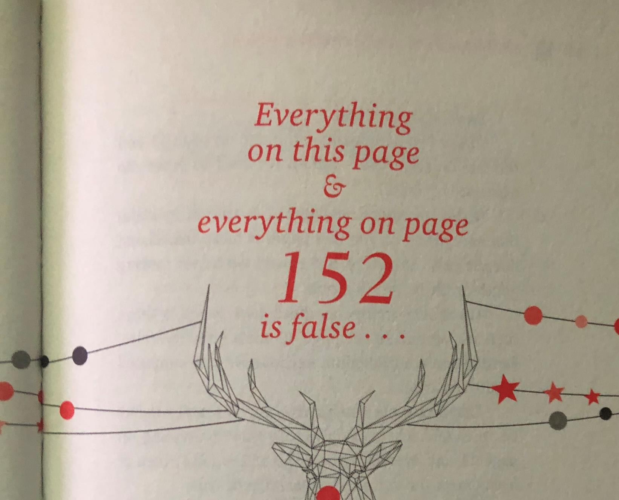

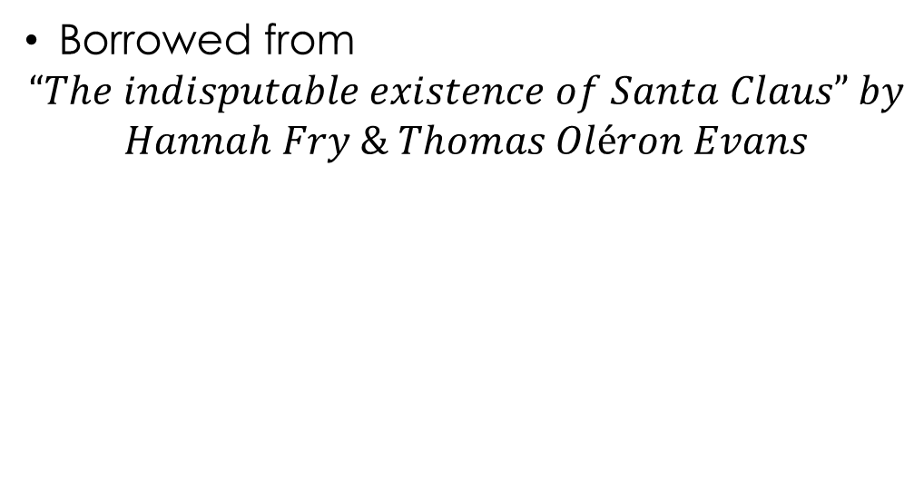
Fun misuse of a contradiction
Borrowed from
$$“The indisputable existence of Santa Claus” by$$
$$Hannah Fry \& Thomas Oléron Evans$$
The concept in play here is called “The liar’s paradox”
Or “Gödel's incompleteness theorem”
https://www.youtube.com/watch?v=tq2AsOjSD-E
(Page 152)

Slide 8
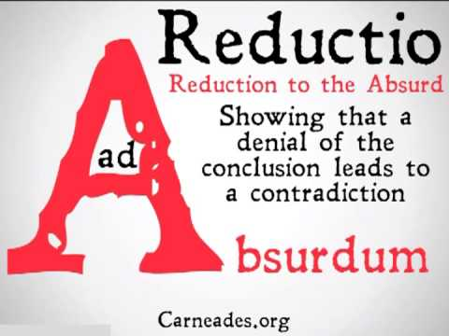
It’s also a version of reduction ad absurdum
There is a good example of this in a calculus question posed here:
https://socratic.org/questions/what-is-the-limit-as-x-approaches-infinity-of-ln-x

Slide 9
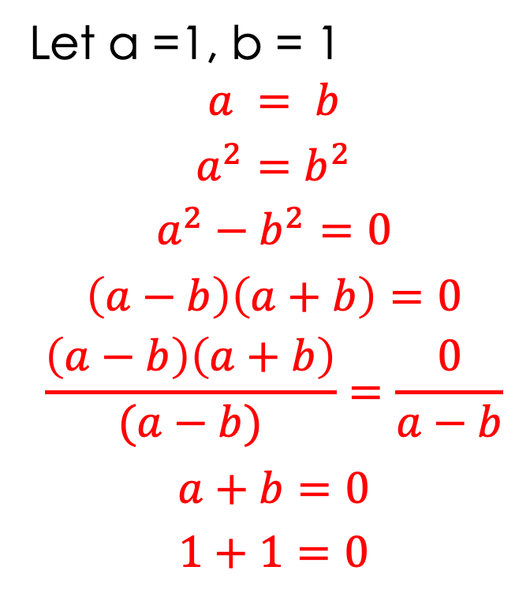
Santa Claus by contradiction:
Let P = Santa Exists
Let Q = 1 + 1 = 2
At least one of the above must be correct right?
What went wrong?!
You can’t divide by zero!
Let a =1, b = 1
$$a = b$$
$$a^{2}=b^{2}$$
$$a^{2}−b^{2}=0$$
$$\left(a−b\right)\left(a+b\right)=0$$
$$\frac{\left(a−b\right)\left(a+b\right)}{(a−b)}=\frac{0}{a−b}$$
$$a+b=0$$
$$1+1=0$$
Therefore Santa Claus exists
Q.E.D.
Remember, it took 300 pages to prove 1+1 = 2 They weren’t kidding

Slide 10
Back to boring math
Proving the square root of 2 is irrational:
https://www.khanacademy.org/math/algebra/x2f8bb11595b61c86:irrational-numbers/x2f8bb11595b61c86:proofs-concerning-irrational-numbers/v/proof-that-square-root-of-2-is-irrational
A bit more complicated:
https://www.youtube.com/watch?v=zEXcsZo4hOQ

Slide 11

Things that aren’t proofs
https://www.youtube.com/watch?v=CAkMUdeB06o
The above video is cool and honestly awesome, but
It isn’t actually a proof
It’s really an attempt at a proof by example and unless you can prove every single right triangle in existence using that method you aren’t getting anywhere
(nor are you going anywhere if you try)

